Slide 1
Export and import schema
Milind Parab

Slide 2
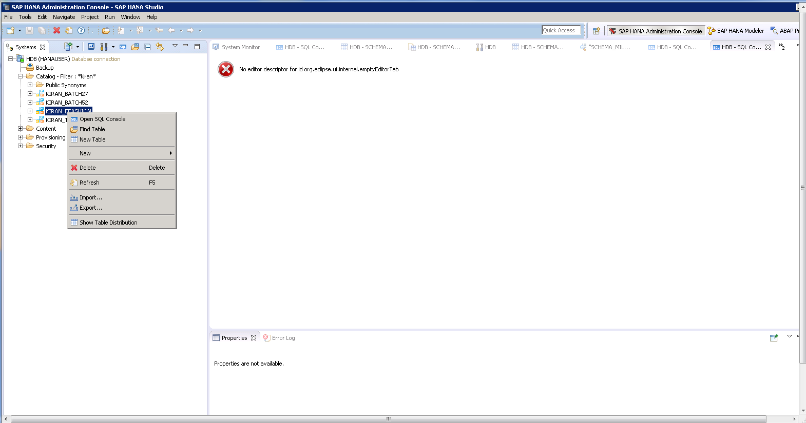
Right click on schema and hit export.

Slide 3
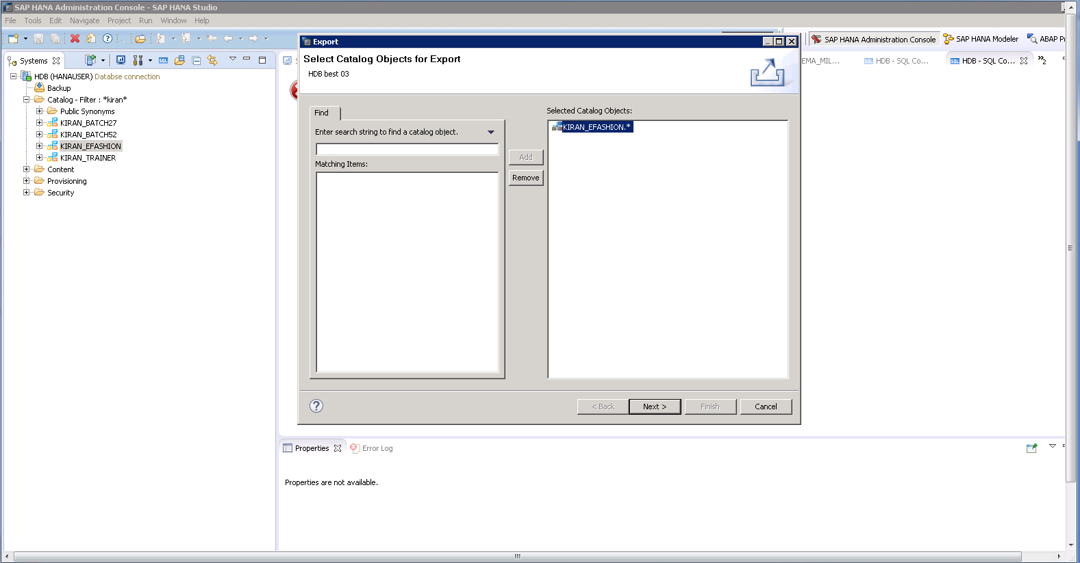
Select schema and hit next.

Slide 4
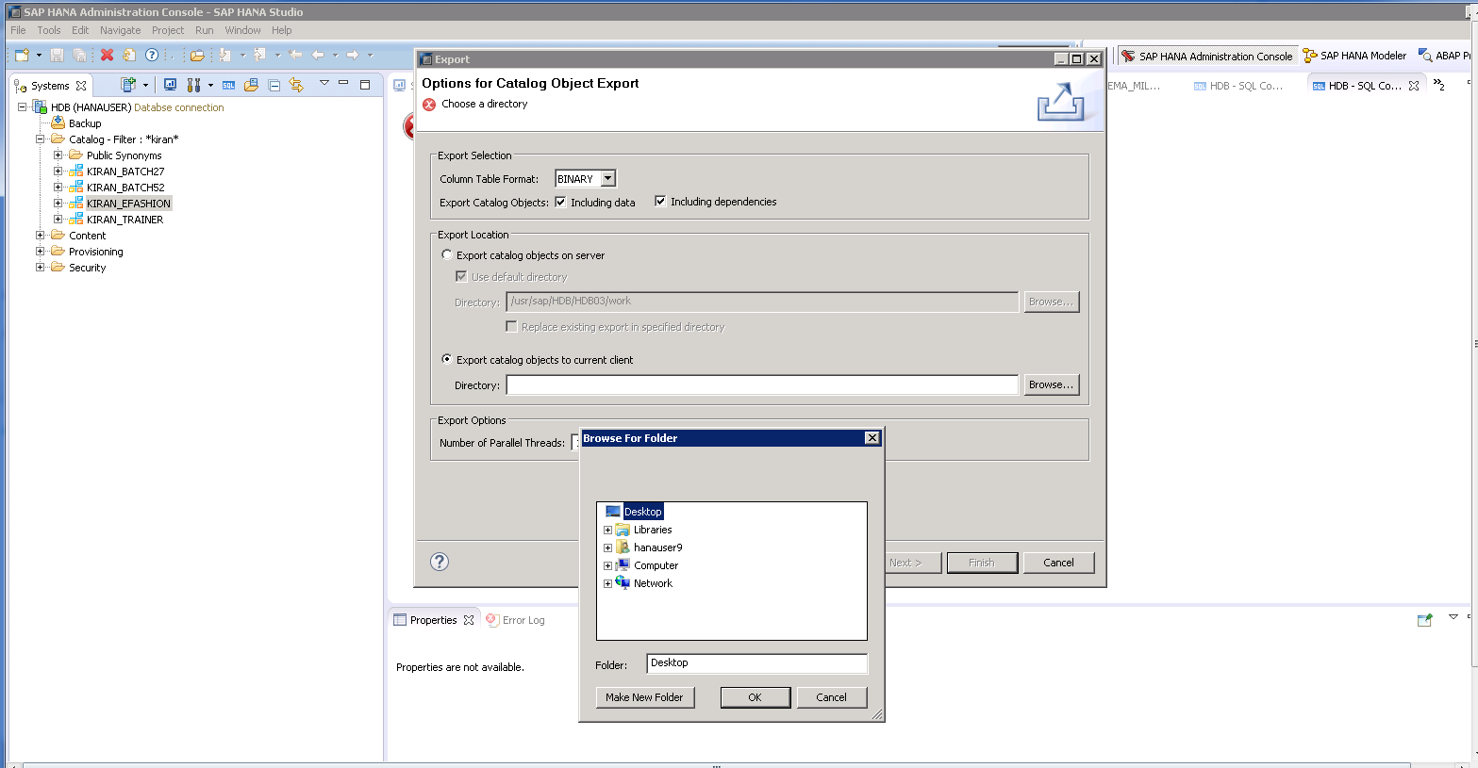
Select export directory and click on finish.

Slide 5
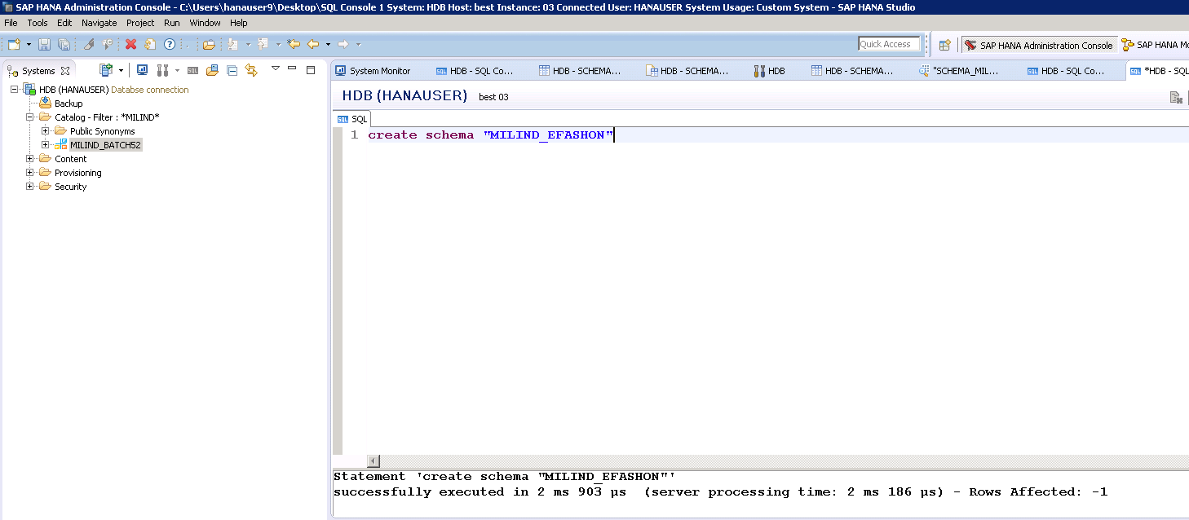
Create a new schema “MILIND_EFASHION”.

Slide 6
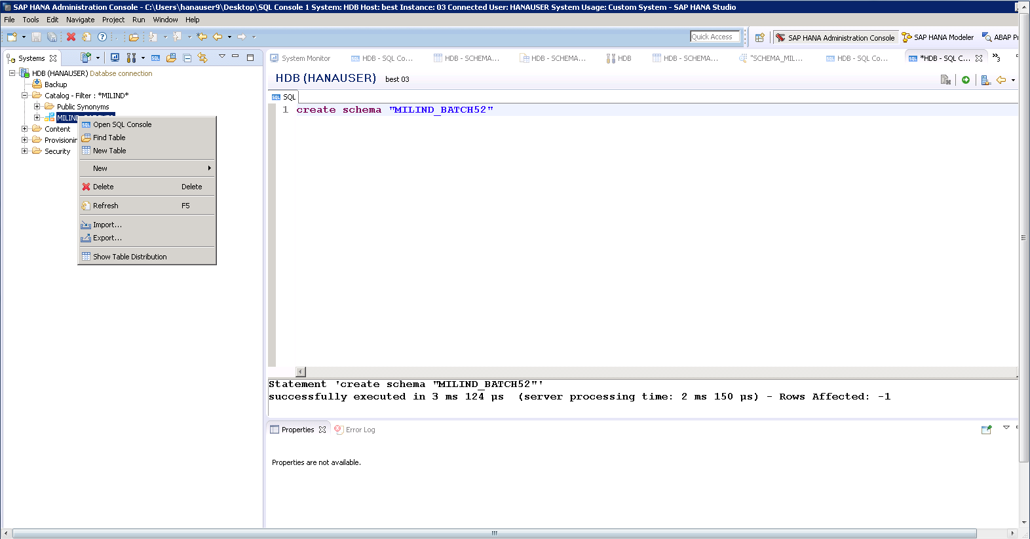
Import “KIRAN_EFASHION” schema.

Slide 7
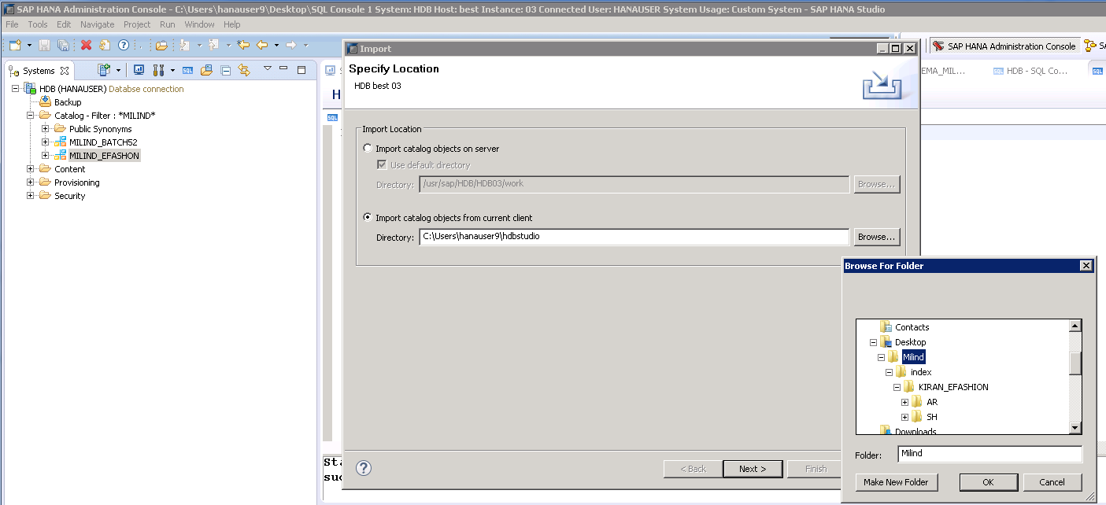
Cont.

Slide 8
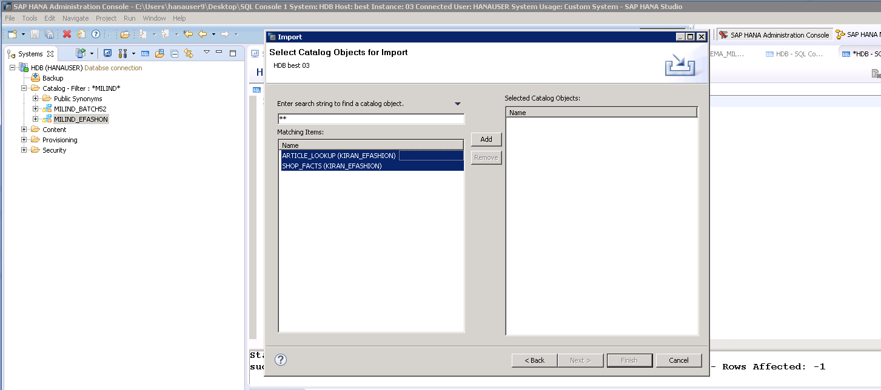
Click on add and hit finish.

